Slide 1
Software Engineering Methodology For Healthcare Application Development
Abdullah Al-Dahmash, Samir El-Masri
Department Of Information Systems, College of Information Sciences
King Saud University, Riyadh, KSA
Neelu Lalband
Dept of Computer Science Engineering
JNTUA Anathapuram, A.P, India
Dr. D. Kavitha
Dept of C.S.E
G.Pulla Reddy college of Engineering (Autonomous) Kurnool, A.P, India
Group Members :
Hasan, Mahmud (17-33881-1)
Islam, Md. Rashedul (19-40559-1)
Rahman, Mohammed Mofizur(19-40120-1)

Slide 2
Presentation Framework:
Introduction : Outlines, Aim, Structure. Specifies the beginning, middle and end.
Theory : Software Development Life Cycle (SDLC).
Waterfall,
Spiral,
V Model,
Rapid Application Development (RAD),
Agile Model,
Big Bang Model
Experimental Method : Discuss about experimental method.
Results : which methodology will be better methodology.
Discussion & Conclusion : Summarizes main points.
Reference : The list of references.

Slide 3
Introduction :
The aim is to achieve the best possible support for patient & Medical care.
This System should Support fair financial, good health and excellence services.
The use of Information system in healthcare industry is dramatically changes.
Software Engineering for Healthcare systems is an engineering Field for IT specialists.
A healthcare system has properties and features that need to be addressed.
The software models have boosted the development of millions of software applications for desktop, mobile devices as well as smart devices.
Agile methodology will supposed to solve the challenges in the healthcare domain.
Focuses on the health care Application systems and development.

Slide 4
Research Background
Advanced mobile communications and portable computation are now combined in handheld devices called “smartphones”, which are also capable of running third-party software.
The number of smartphone users is growing rapidly, including among healthcare professionals. The purpose of this study is classify smartphone-based healthcare technologies as discussed in academic literature according to their functionalities, and summarize articles in each category.
Development of quality heathcare systems that meet complex nature of healthcare delivery,with streamlined management of patient information records across the extensive medical care settings is a huge challenge.In order to archieve accuracy and quality,best SDLC model should be proposed.

Slide 5
Research Objective
The Goal of our research is improved the patient care. Such as : by improving the accessibility, by making information belonging to patients, by improving patient administration procedure.
To improve the management efficiency of healthcare.
To form an integral part of a larger quality improvement program in the department .
The main purpose of Healthcare Application is to book appointment with doctors and buy medicines online without having to travel to hospital.

Slide 6
Problem Statement
1.Misdiagonosis
2.Limited access to advance clinician Training
3.Opioid Overdose crisis
4.Cost of healthcare Services

Slide 7
Research Question
What are the different SDLC models to develop any kind of software Application?
Which is the best SDLC suitable for smart healthcare application?
What are the Research Challenges of software engineering application for smart healthcare application?

Slide 8
Solution
1) Popular SDLC models include the waterfall model, spiral model, V model, Agile Model and Big Bang Model
2) Agile is comparatively better SDLC methodology than other software engineering methodologies.
3) Factor analysis resulted in the identification of six problem factors:
User Knowledge,
Programmer Effectiveness,
Product Quality,
Programmer Time Availability,
Machine Requirements,
System Reliability.

Slide 9
Common Software Engineering Methodologies :
Various models of software development have been defined to be applied during software implementation process. Such models can be classified into two categories.
Traditional and Classical Models :
Waterfall Model
Spiral Model
V Model
Rapid Application Development Model
Big Bang Model
Modern and Popular Models :
Agile Model

Slide 10
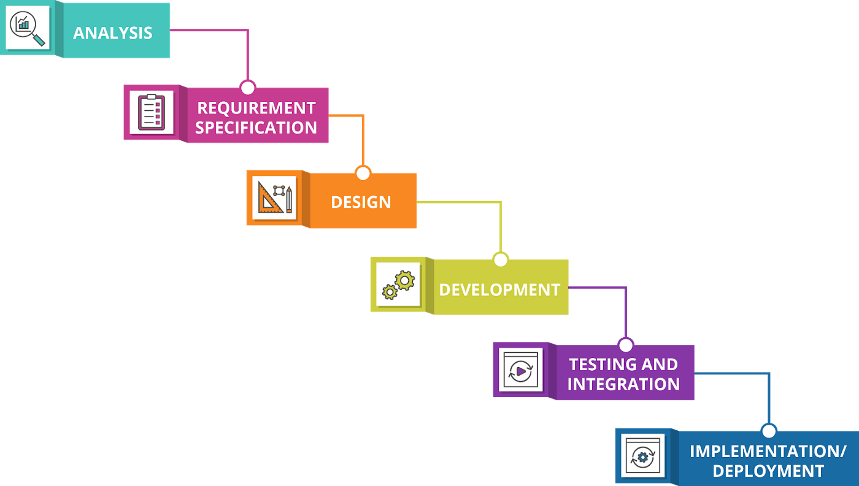
Waterfall Model:
Limitations :
One way street
Overlapping
Interaction
Support delivery of system
Feedback path
Not Flexible

Slide 11
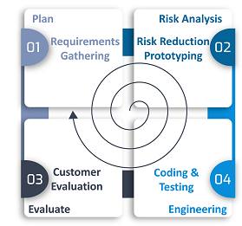
Spiral Model :
Limitations :
It is not suitable for small projects as it is expensive.
It is much more complex than other SDLC models. Process is complex.
Too much dependable on Risk Analysis and requires highly specific expertise.
Difficulty in time management.
Spiral may go on indefinitely.
End of the project may not be known early.

Slide 12
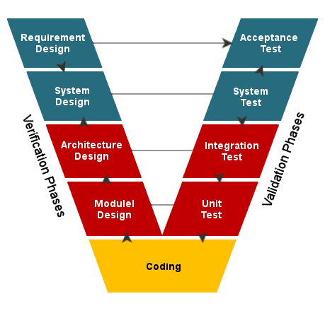
V Model :
Limitations :
High risk and uncertainty.
Not good for complex and object-oriented projects.
Poor model for long and ongoing projects.
Not suitable for the projects where requirements are at a moderate to high risk of changing.
Once an application is in the testing stage, it is difficult to go back and change a functionality.

Slide 13
Rapid Application Development :
Limitations :
Depends on strong team and individual performances
Only system that can be modularized can be built using RAD
Requires highly skilled developers/designers.
High dependency on modeling skills
Inapplicable to cheaper projects

Slide 14
Agile Model:
Limitations :
Maintenance is difficult for large projects
Lack of emphasis on necessary designing and documentation.
The project can easily get off the track

Slide 15
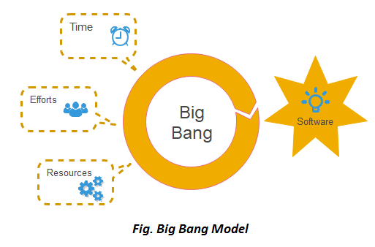
Big Bang Model
Limitations :
Not good for complex and object-oriented projects.
Can be very expensive
Poor model for long projects
Risk is very high
Uncertain

Slide 16
Comparison between some most common software methodologies
Methodology: Issue | Waterfall | Spiral | V Model | Agile | Big Bang
Reliability | Low | High | Low | High | Moderate
Performance | High | Moderate | Low | High | Low
Security | High | Low | High | High | Low
Availability | Moderate | Moderate | Low | Moderate | Low

Slide 17
Research Method
A formal SDLC model consists of the following phases
Planning
Analysis & Research
Designing
Implementation
Testing
Debugging
Deployment and Evolution

Slide 18
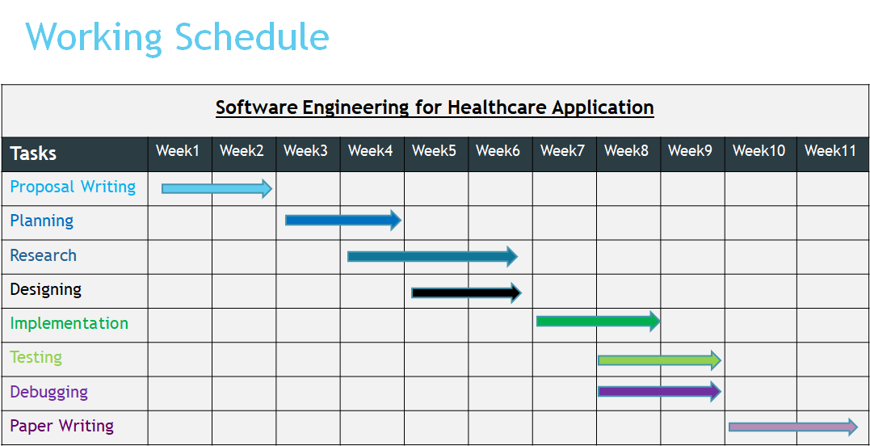

Slide 19
Ethical Consideration
1.Privacy
2.Risk
3.Business Ethics
4.Transperancy
Transparency
Business Ethics
Privacy
Risk

Slide 20
Conclusion
Brief review of some common software engineering methodologies.
Limitation discussion.
Comparison between some common software engineering methodologies.
Discussion about the research method and ethical consideration.

Slide 21
References:
Kneuper, R. (2017). Sixty Years of Software Development Life Cycle Models. IEEE Annals of the History of Computing, 39(3), 41-54.
Weber-Jahnke, J. H., Price, M., & Williams, J. (2013, May). Software engineering in health care: Is it really different? And how to gain impact. In Proceedings of the 5th International Workshop on Software Engineering in Health Care (pp. 1-4). IEEE Press.
Stroulia, E., Chodos, D., Boers, N. M., Huang, J., Gburzynski, P., & Nikolaidis, I. (2009, May). Software engineering for health education and care delivery systems: The Smart Condo project. In Software Engineering in Health Care, 2009. SEHC'09. ICSE Workshop on (pp. 20-28). IEEE.
Richardson, I., Reid, L., & O’Leary, P. (2016, May). Healthcare systems quality: development and use. In Software Engineering in Healthcare Systems (SEHS), IEEE/ACM International Workshop on (pp. 50-53). IEEE.
SEBoK, "IEEE Computer Society," 2017. [Online]. Available: http://sebokwiki.org/wiki/Healthcare_Systems_Engineering. [Accessed 27 01 2018].
Rastogi, V. (2015). Software Development Life Cycle Models-Comparison, Consequences. International Journal of Computer Science and Information Technologies, 6(1), 168- 172.

Slide 22


Slide 23


